Slide 1
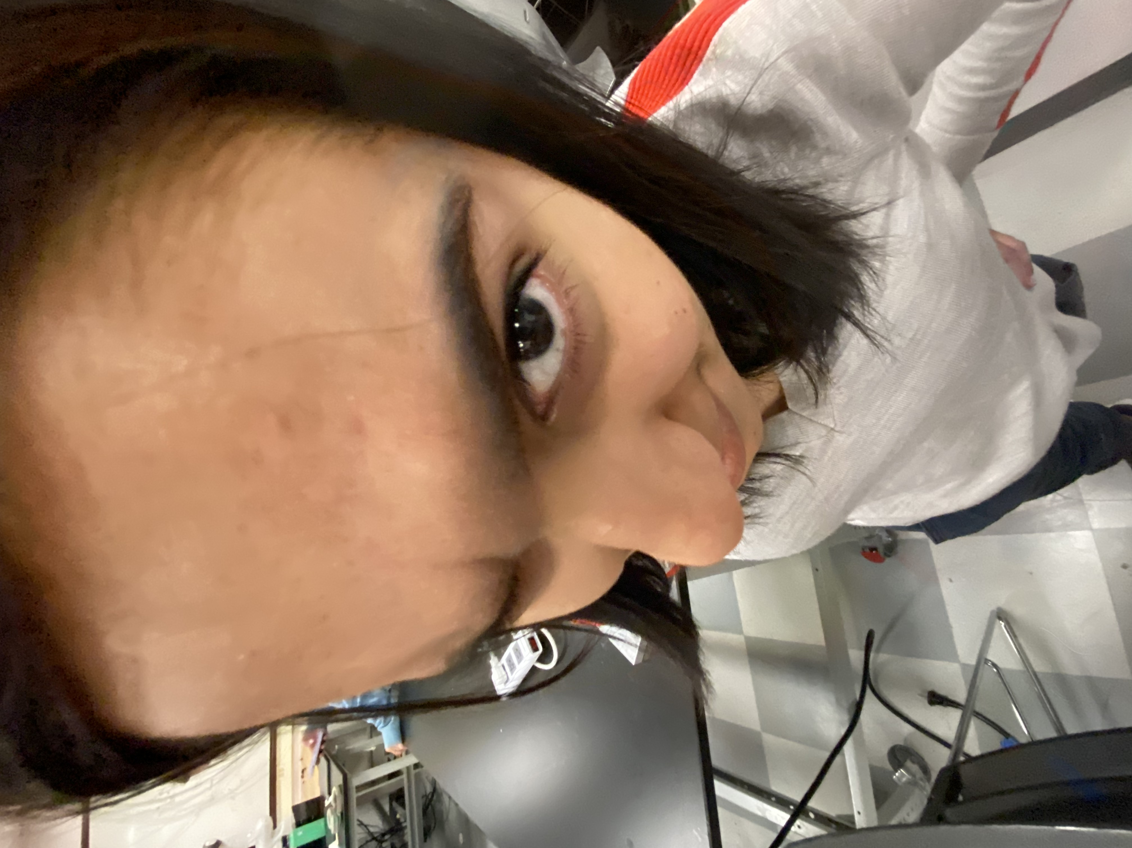
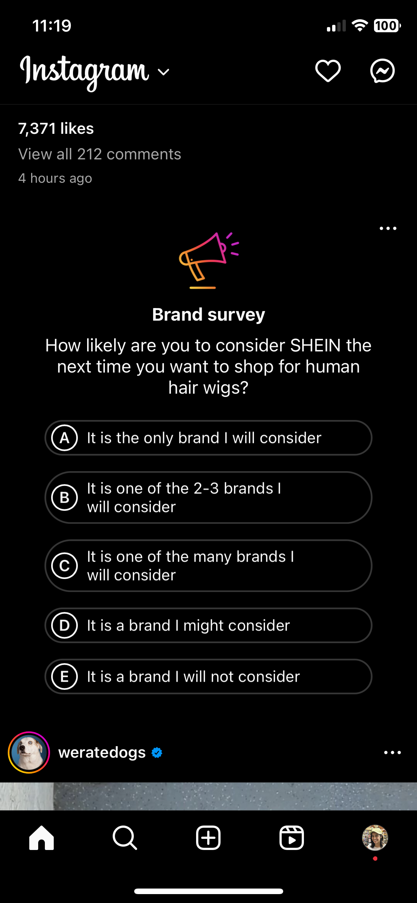

Final Portfolio
MEAM 247 2023C
Ashna Khemani

Slide 2
Read This Slide
The Portfolio Meeting is an Honest Conversation About Your Learning, the Course, and Other Things
Submitting ANY Deliberately Misleading Content in the Portfolio is Grounds for an “F” Grade in the Course and Referal to the Center for Community Standards & Accountability (https://csa.upenn.edu/)
Examples (But Not Complete List)
Submitting Photo or Graph or Work You Didn’t Personally Create without Complete & Explicit Attribution (2 “F” Grades Given Spring 2023)
Failure to Disclose Missing or Substantially Incomplete Assignments
Exaggeration of Attendance Record in Lecture or Lab Sections
Note: Concept Map “Errors” Not Dishonest: Sometimes We Don’t Know What We Don’t Know!

Slide 3
Canvas Lab Assignment Summary
Assignments Submitted on Time (List)
Lab 1 Night Light
Lab 2 Fluid Fun - updated graphs/analysis
Lab 3 Failure is an Option
Penn Park Adventure (Trusses!)
Lab 4
Individual assignment
Final Demo
Lab 5
Tension Strap preliminary design
Final design presentation
Assignments Submitted Late (List)
Assignments Submitted Rogue (List & Explain Briefly)
Lab 5 Final Memo (did not get to test until after Thanksgiving Break. Fire alarm + exam for another class the same day)
Lab 6 (didn’t understand the assignment)
Lab 7 (didn’t know what the deliverable was, where to submit)
Assignments Missing (List & Explain Briefly)
Lab 2 Fluid Fun - initial graphs, hard copy (did it the morning of lecture and did not have time to print)

Slide 4
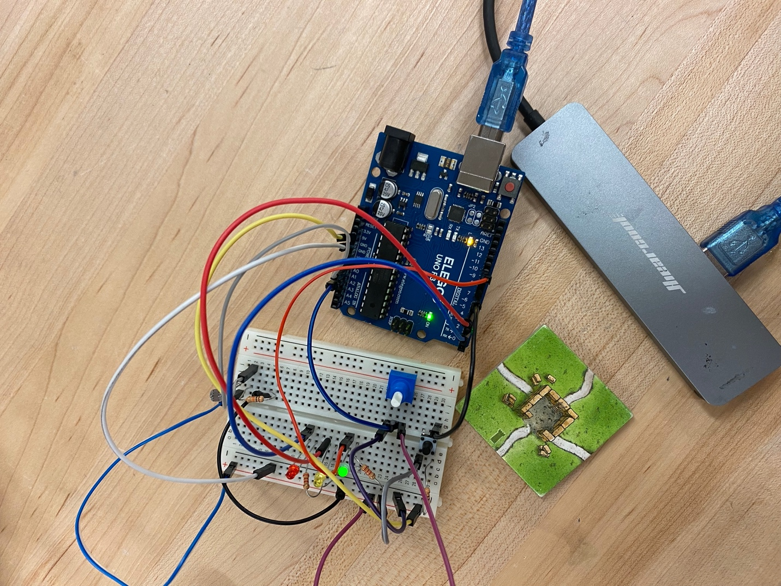
Lab1: Night Light (Photo & Code Screenshot)

Slide 5
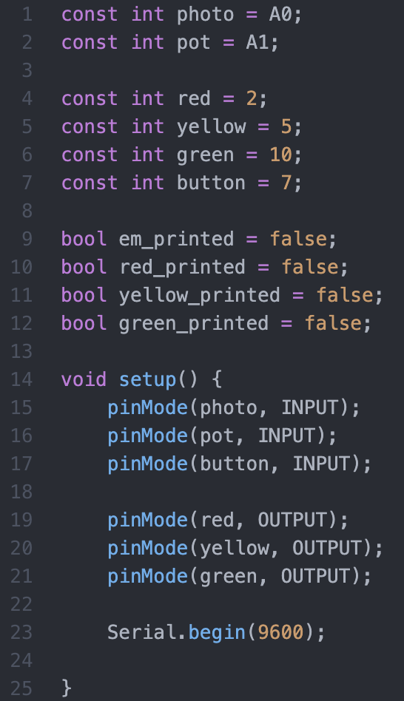
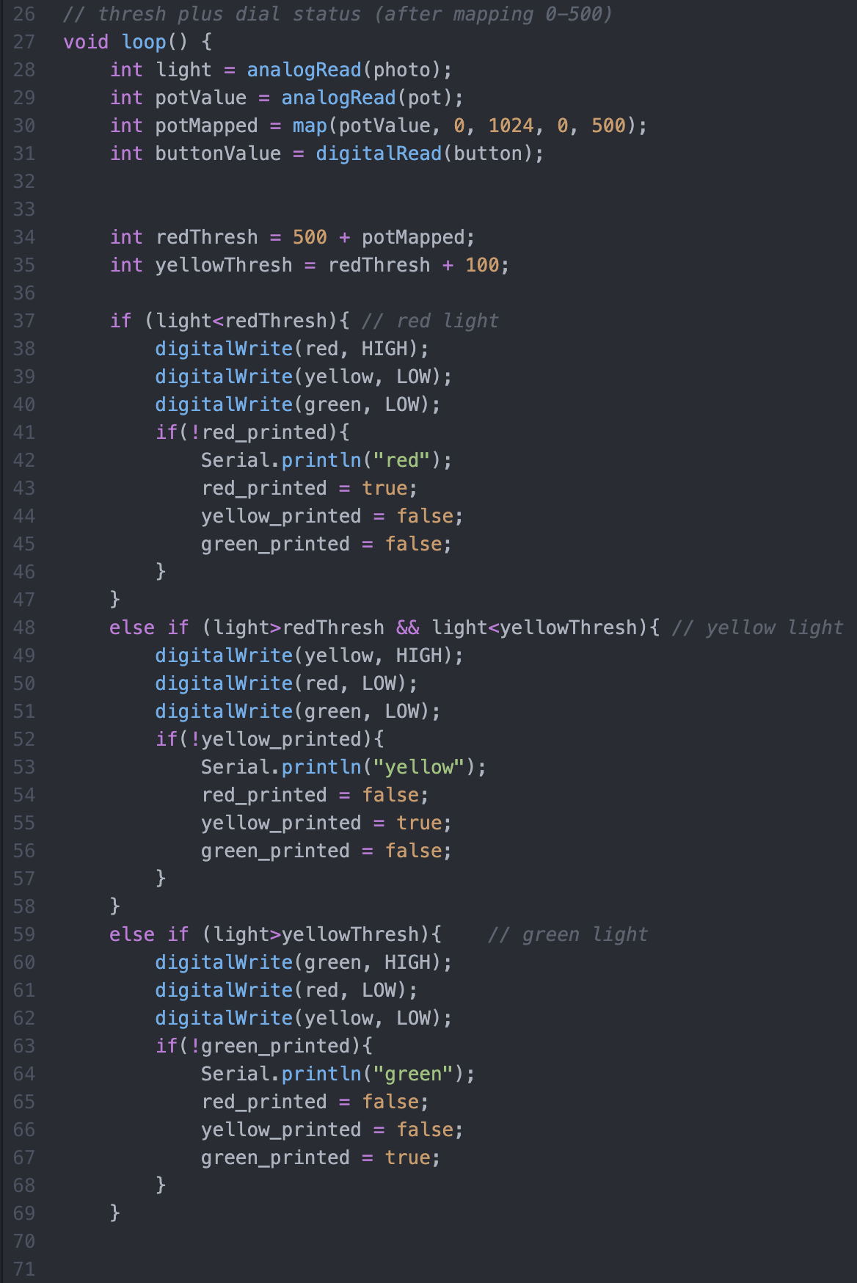
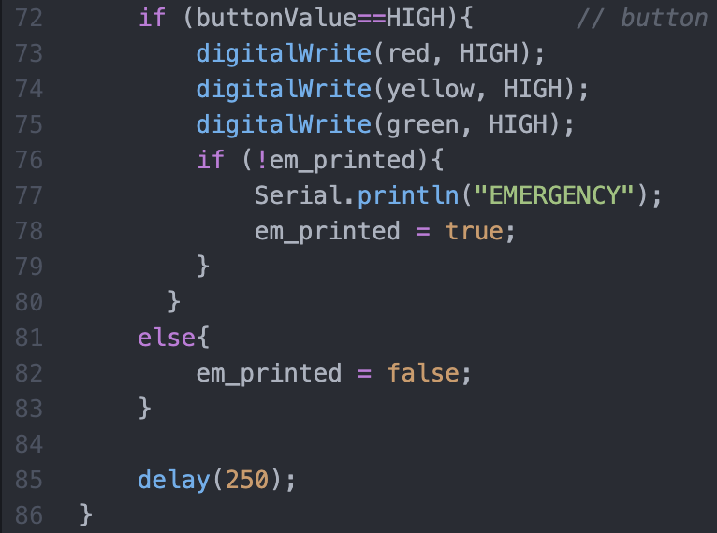
Lab1: Night Light (Photo & Code Screenshot)

Slide 6
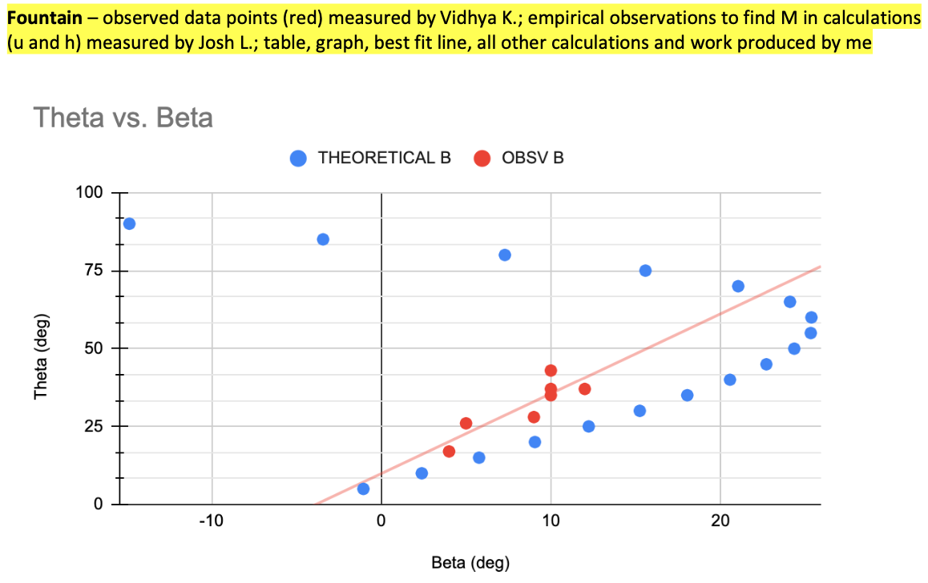
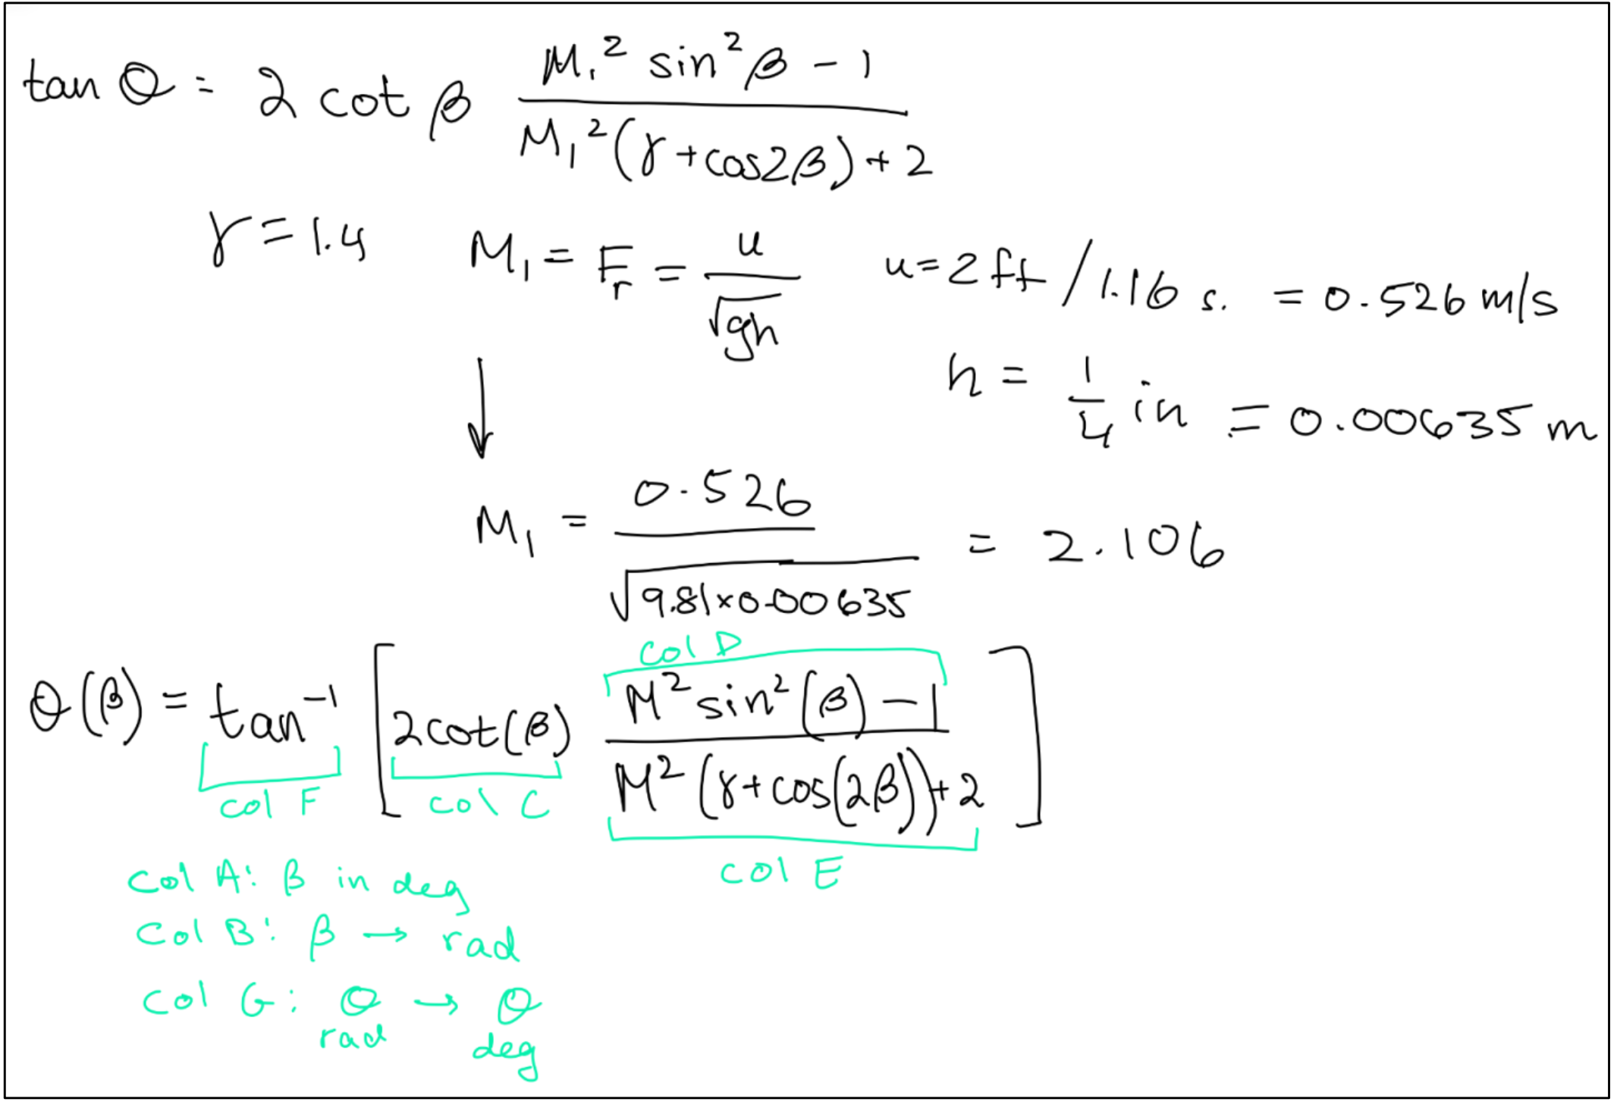
Lab2: Updated Fluid Graphs & Analysis

Slide 7
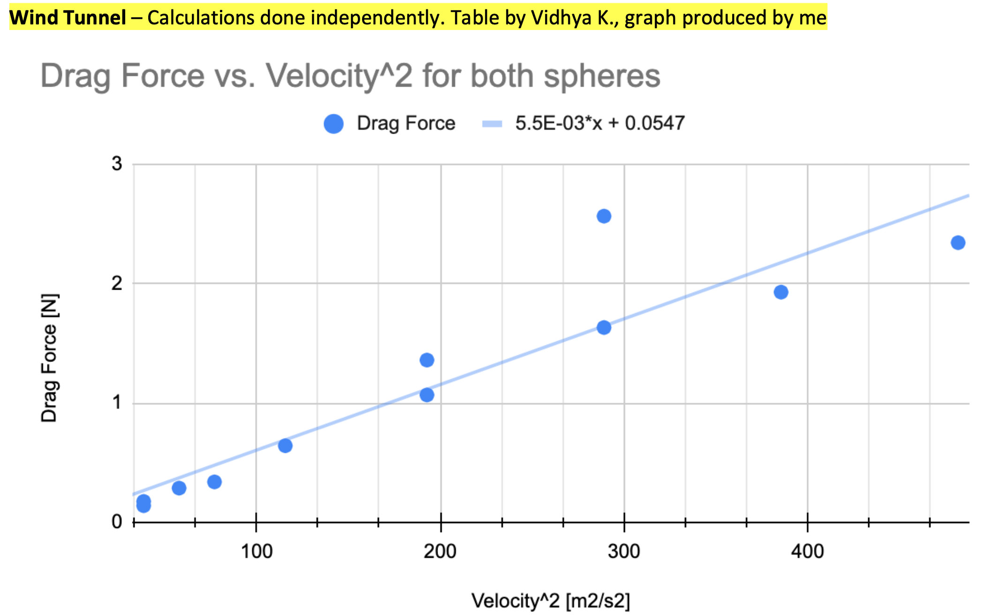
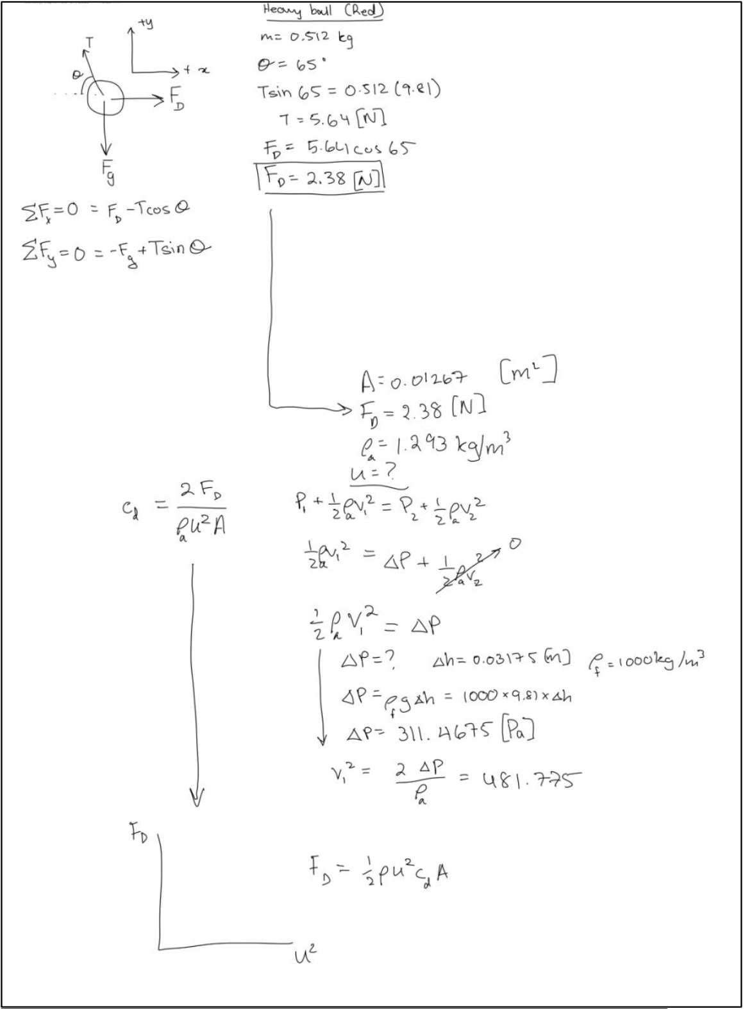
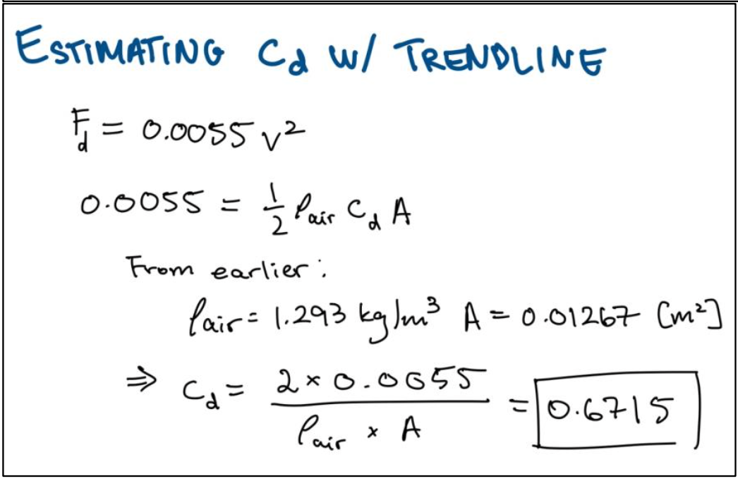
Lab2: Updated Fluid Graphs & Analysis

Slide 8
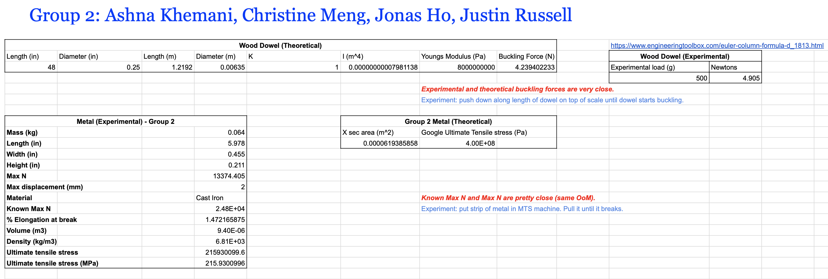
Lab3: Fracture & Buckling: Photos, Tables, Analysis

Slide 9
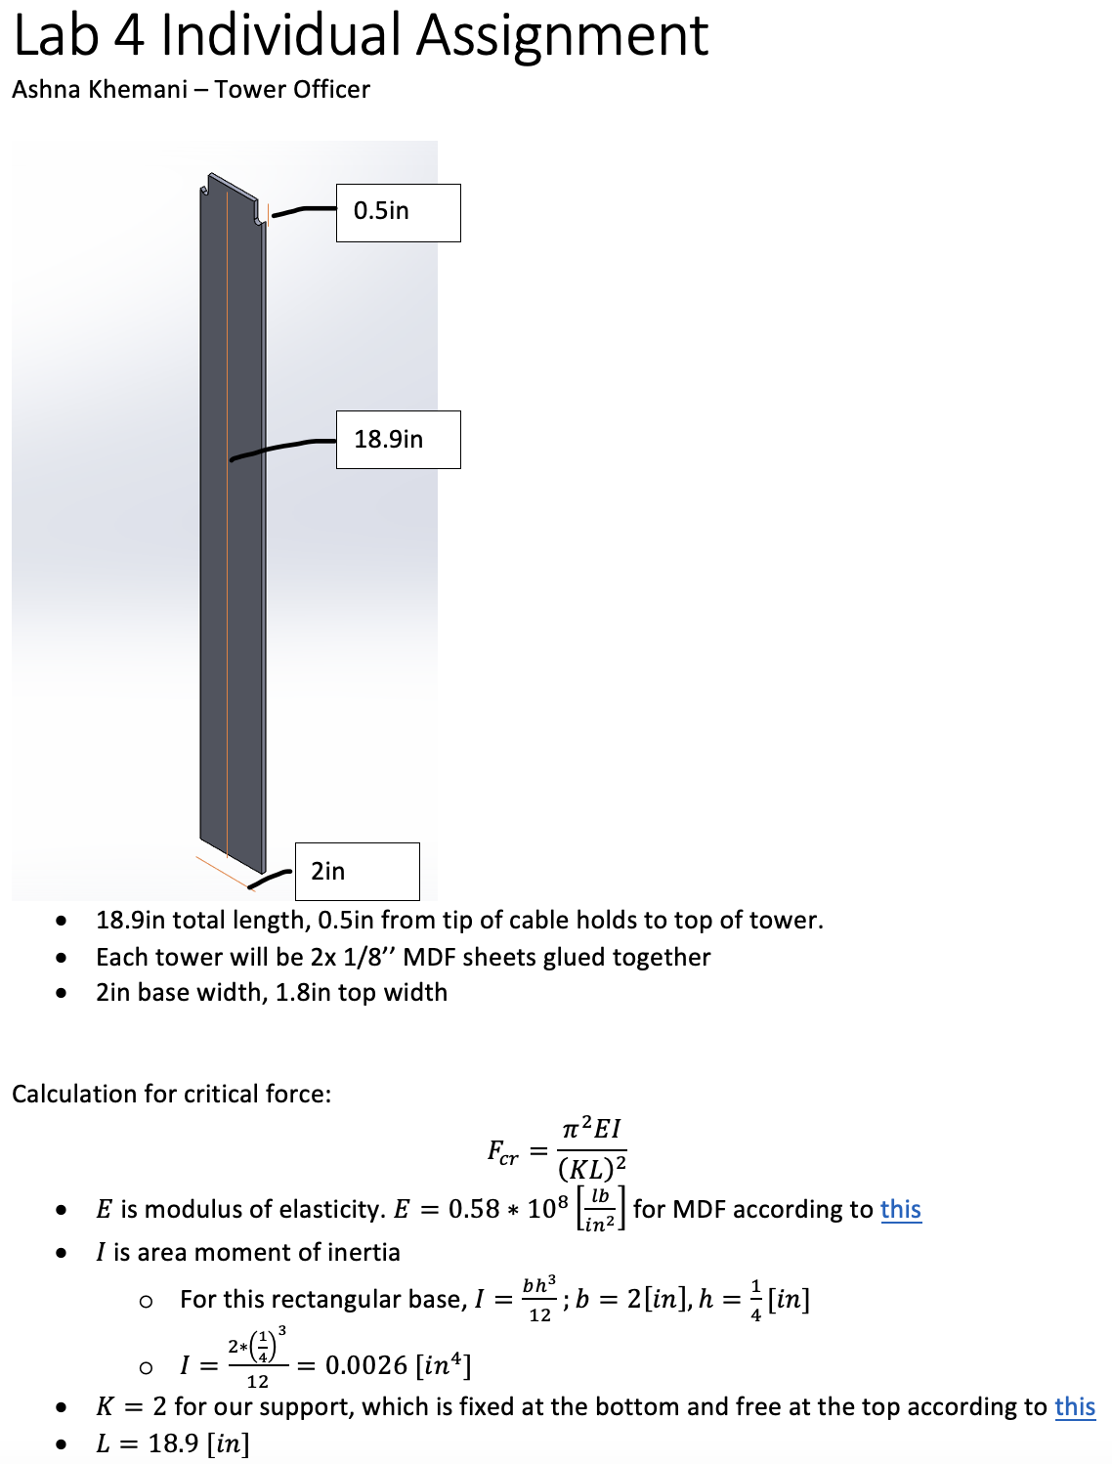
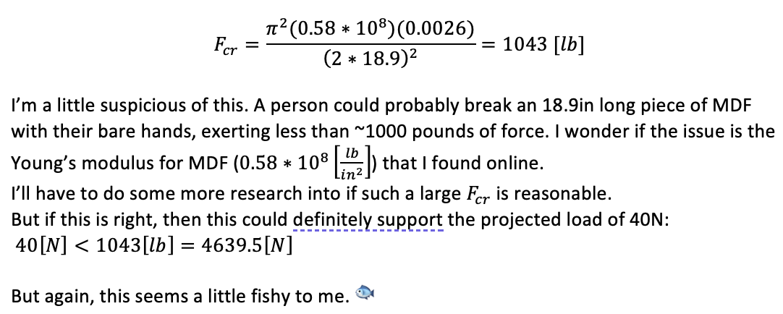
Lab4: Suspension Bridge Analysis & Test Photo

Slide 10
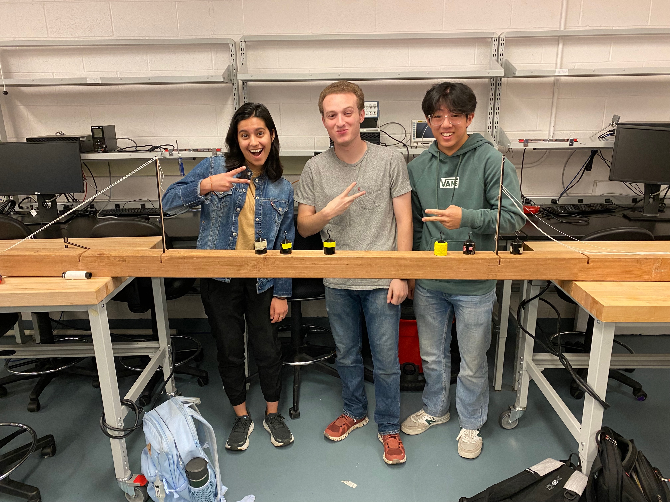
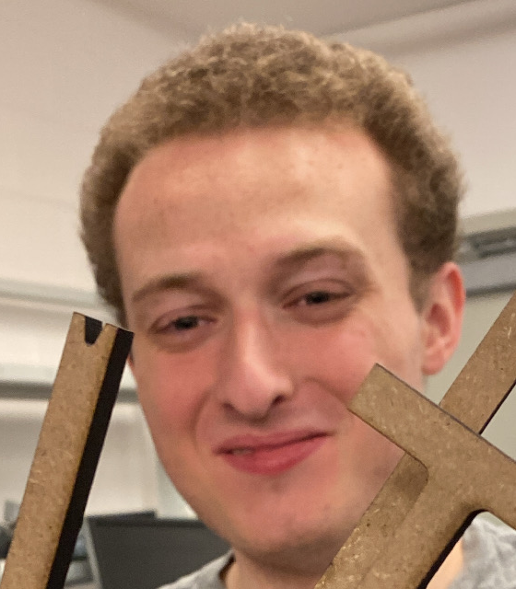

Lab4: Suspension Bridge Analysis & Test Photo

Slide 11
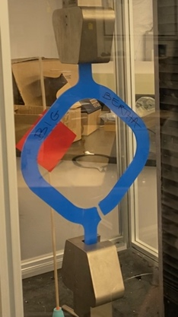
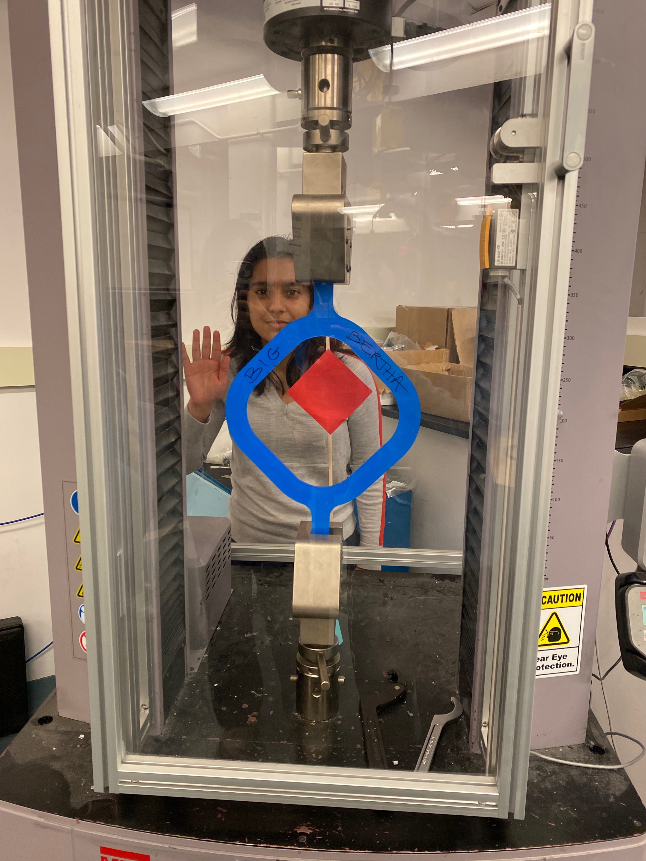
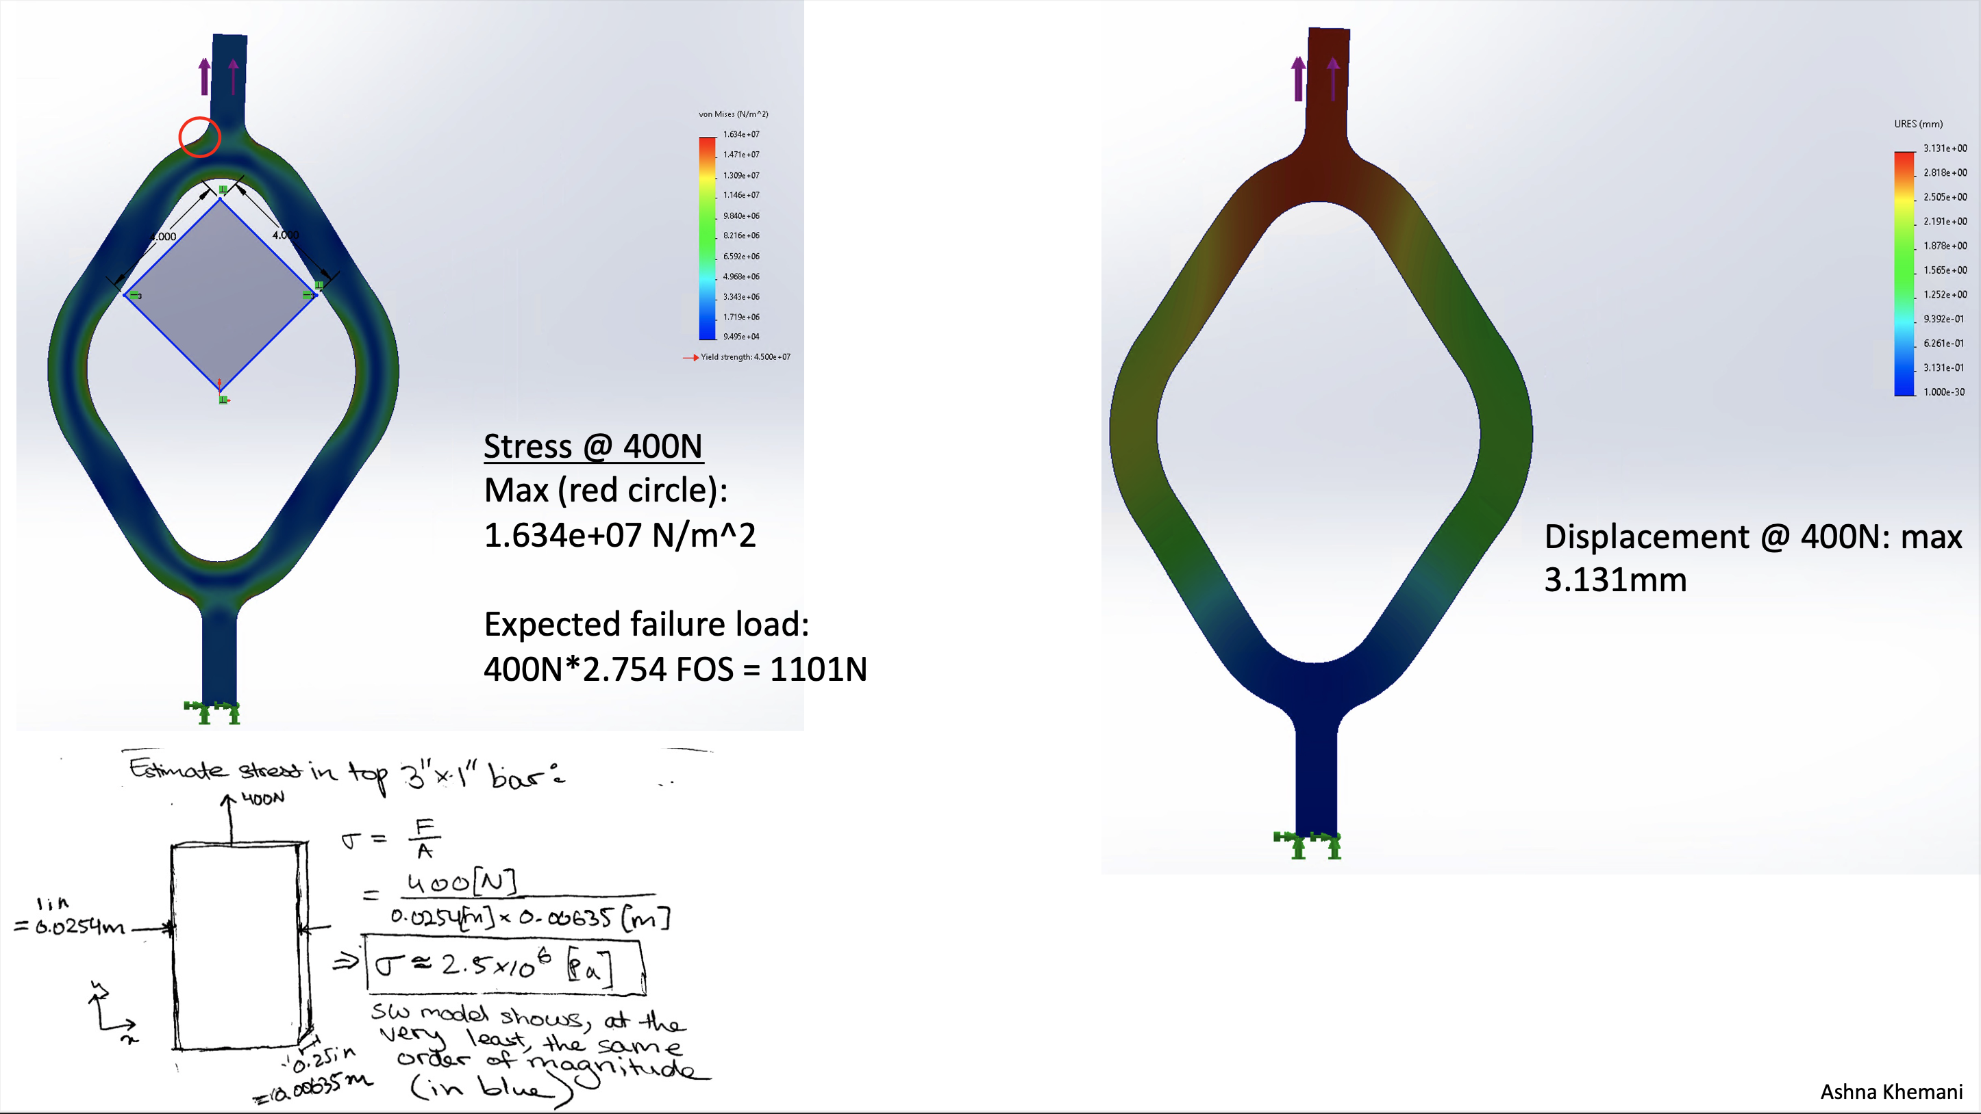
Lab5: Tension Strap Final FEA & Test Photo
A wistful goodbye to my beloved Big Bertha
~1000[N] later…

Slide 12
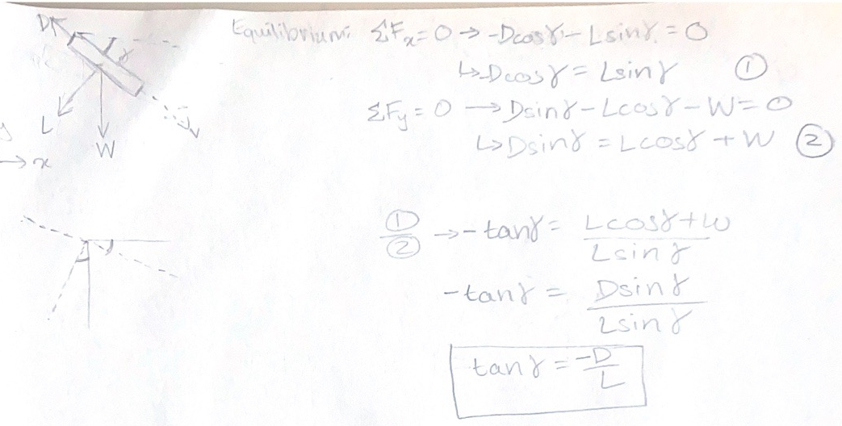
Lab6: Airplane Flight Test Media & Graph
FBD + equation

Slide 13
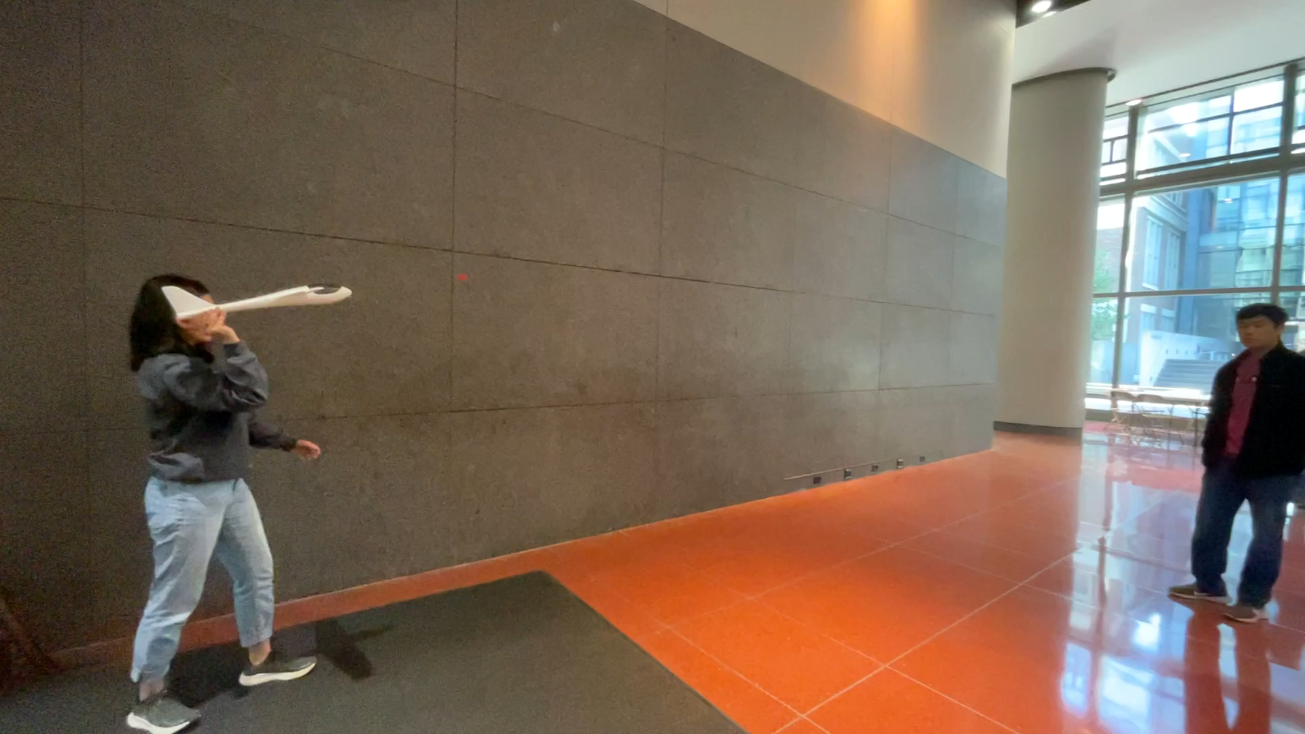
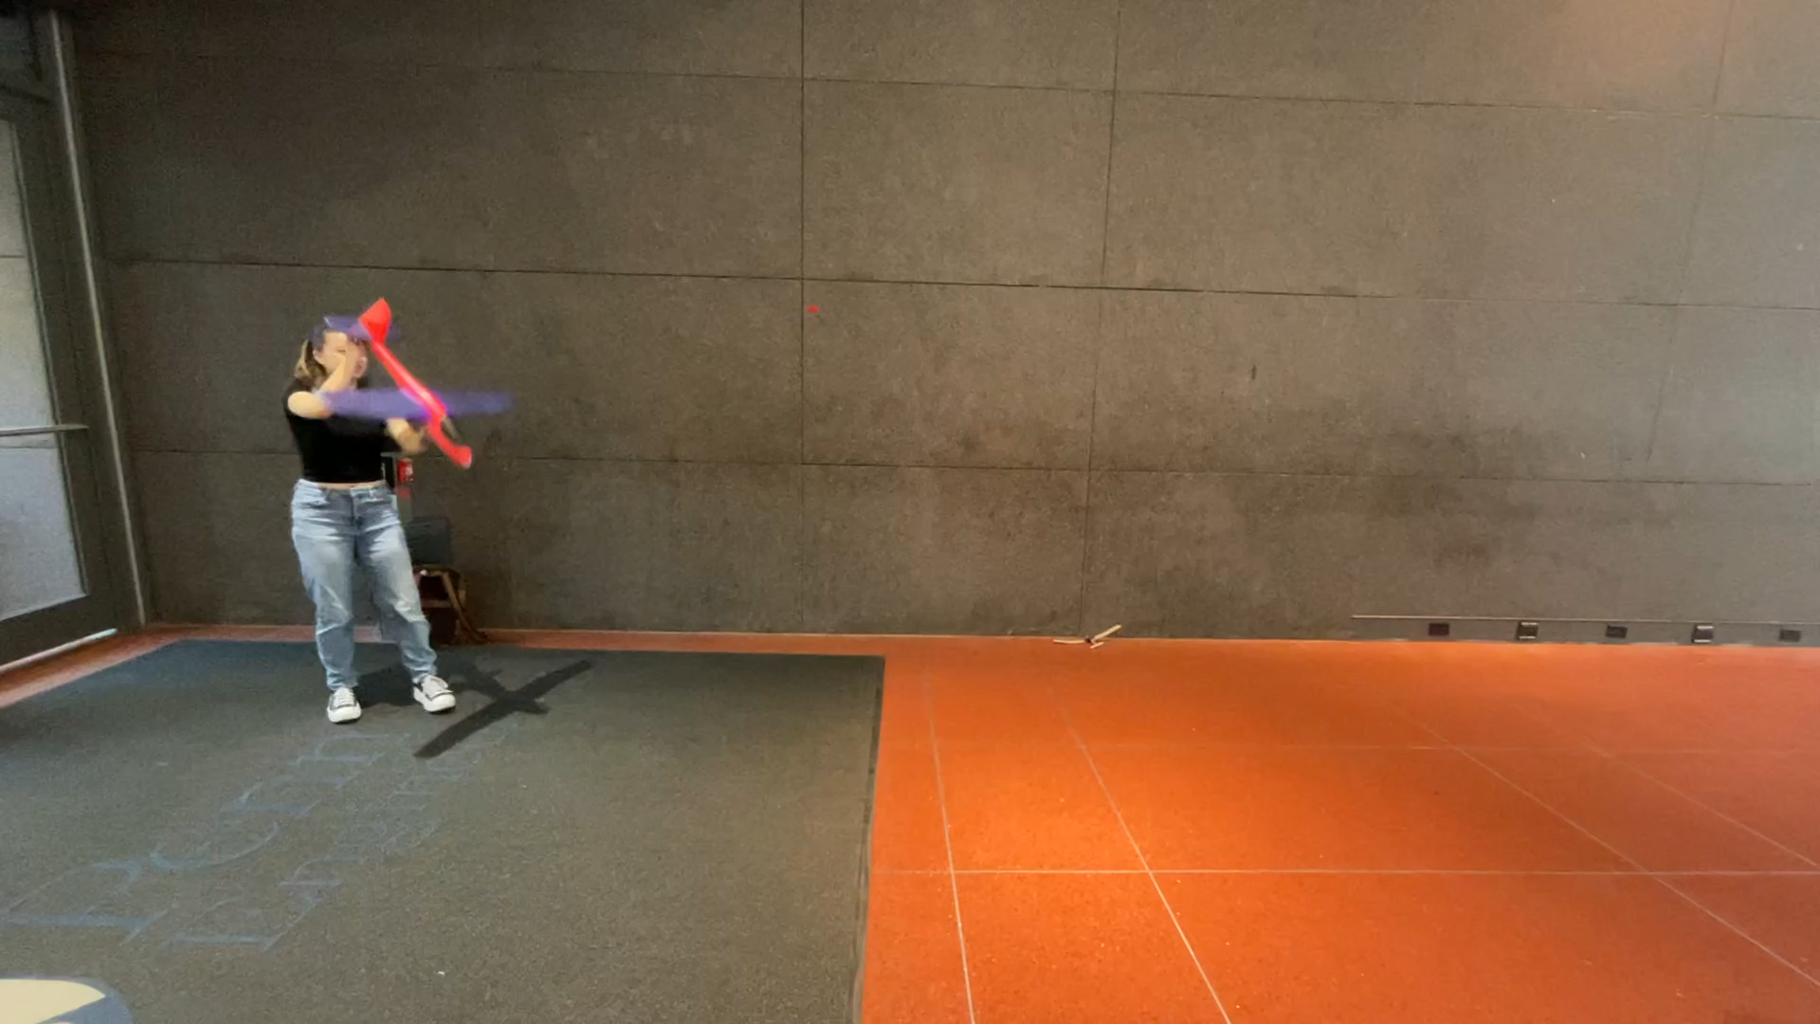
Lab6: Airplane Flight Test Media & Graph
Flight Videos (with Kayla)

Slide 14
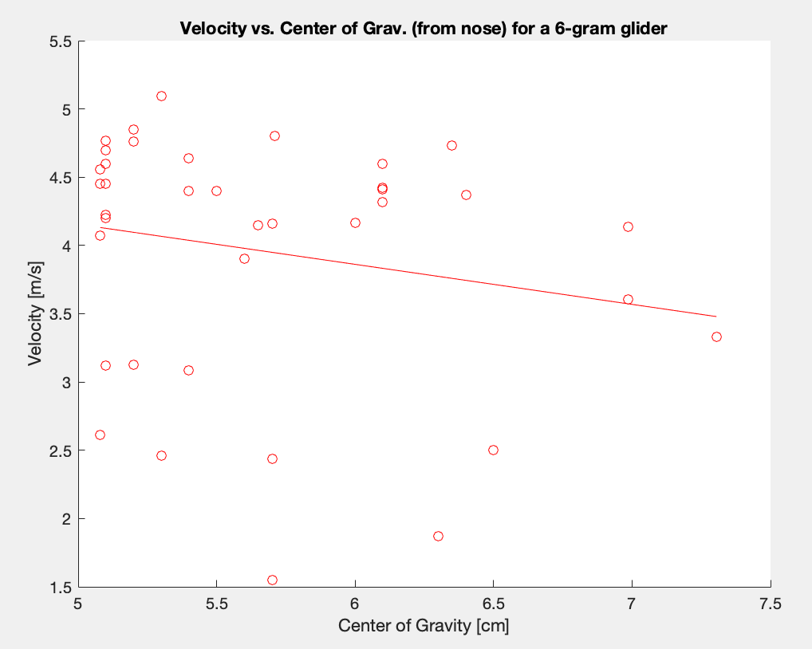
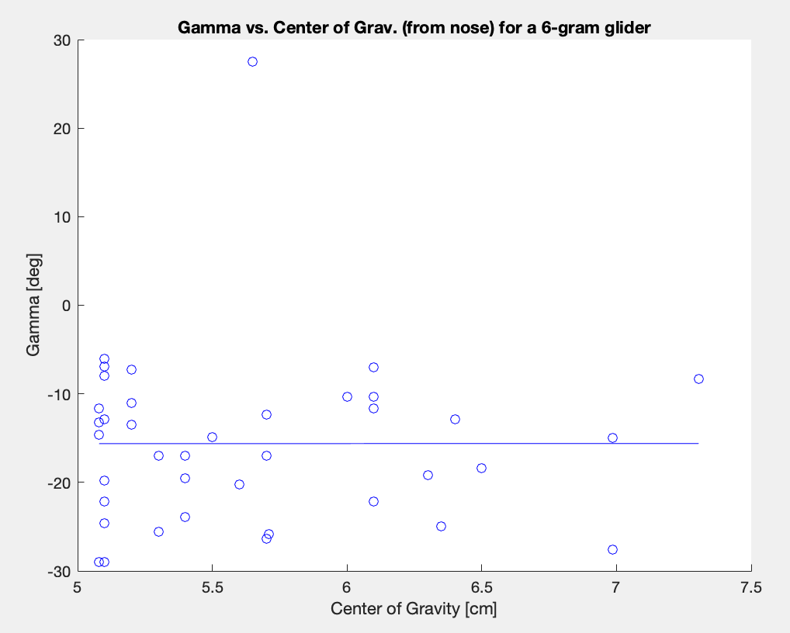
Lab6: Airplane Flight Test Media & Graph
Graphs (from 10:15 section class data)
Hard to find patterns; noisy data ☹

Slide 15
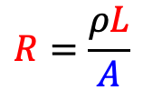
Lab7: Load Cell Explanation & Sphere Drag Graph
Load cell explanation
Load cell: bend beam → elongates and reduces cross section of the squiggly wire across the deforming surface
$$R=\frac{ρL}{A}$$
Measure the change in resistance (the change in voltage drop) across the wire → can give you an idea of how much the wire deformed → how much the beam bent

Slide 16
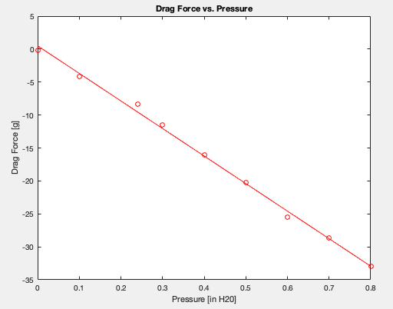
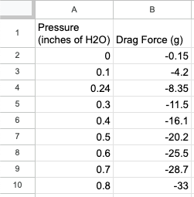
Lab7: Load Cell Explanation & Sphere Drag Graph
Sphere Drag Graph (data from 10:15 section)

Slide 17
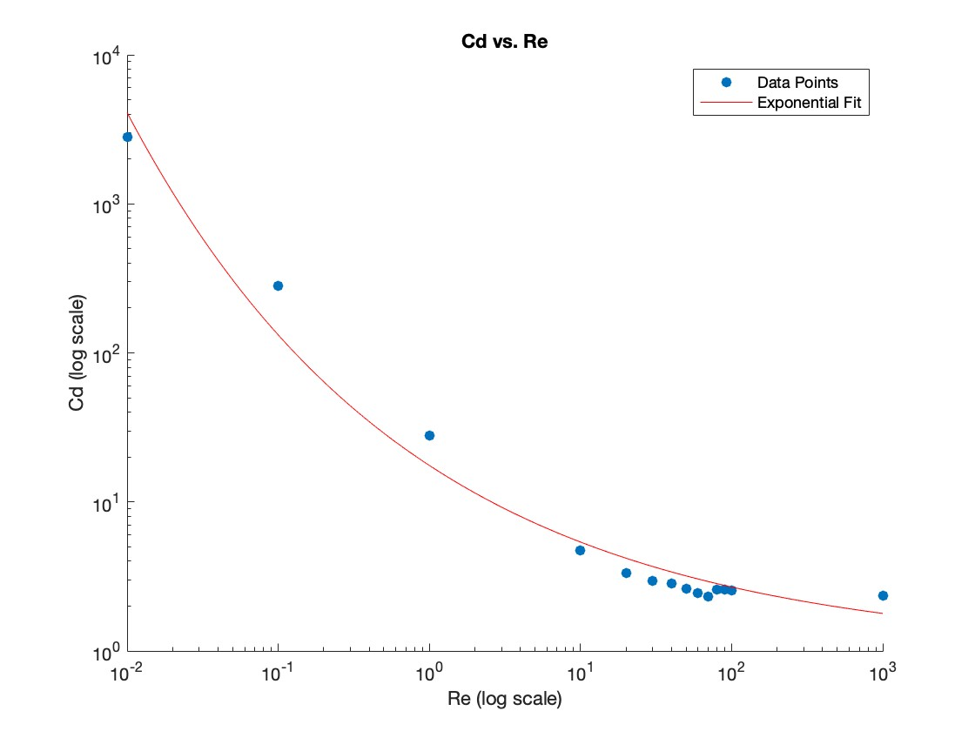
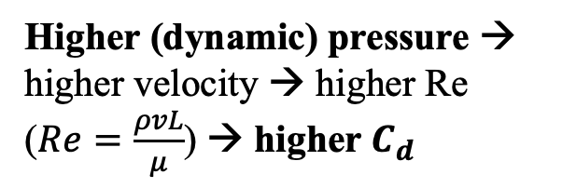
Lab7: Load Cell Explanation & Sphere Drag Graph
Makes sense, compared to MEAM 2020 project (with Kayla and Christine)!
Higher (dynamic) pressure → higher velocity → higher Re ($Re=\frac{ρvL}{μ}$) → higher $C_{d}$

Slide 18
Lab Section Contribution & Learning Summary
Attendance Summary
Missed 1 section (exam the same day as Lab 5 demo; tested part after Thanksgiving Break)
What I Contributed to Section Meetings
Collecting and organizing data
Helping classmates fix technical problems they ran into (ex: debugging code for Lab 1, figuring out FEA for Lab 5)
Or being equally confused and trying to solve things together (ex: graphs for Lab 2)
What I Learned in Section Meetings
Learned how to throw a model plane so it would make a loop :D
Learned enough to build Lab 1 circuit on my own (did not feel confident with circuits before)
How rationalize calculations using logic + ballpark estimates

Slide 19
Lecture Attendance Summary
How Many Lectures Were Missed?
None (maybe 1)
In-Lecture Quizzes Completed?
4/4 listed on Canvas but I feel like there were more than that

Slide 20
Concept Map (Understand; Confused; Lost)
FEA
Analyzing stress/strain for design (Lab 5)
Circuits
Arduino/code
Deformations
Data Collection & Analysis (making cool graphs)
Euler’s Buckling Load
Drag
Shockwaves (Lab 2)
Helicopters and anything that flies.

Slide 21
ABET Self-Assessment (Strong / Emerging / Weak)
An ability to function effectively on a team whose members together provide leadership, create a collaborative and inclusive environment, establish goals, plan tasks, and meet objectives.
I’m a great collaborator…
Organized, maintaining documentation and communication, timely, finish what’s expected of me
Ex: multiple iterations for bridge, documenting all results
Ex: Penn rocketry – organizing all team documentation/resources for competition, delegating work for airframe design and construction. Recruitment, logistics, planning
…but I could do better
More creativity with some of the labs
Ex: more creative design for Lab 5
Ex: more sophisticated design for bridge instead of a rod that minimized cost (and didn’t even fully work)

Slide 22
Looking Back on the Course
Things That Worked Well: Keep or Expand On These
Lab sections – collecting data and using it to prove trends that theory shows
Group projects – good opportunity to look at things in different ways, learn from peers. Fun!
“No-right-answer” feel to labs – encouragement to mess around and find out
Things That Should Be Improved
Clearer instructions on labs – what deliverables are
Lecture – some of the discussions on quiz solutions move a little fast and are hard to follow
Other Reflections
Genuinely the class I looked forward to every week, even if I had no idea what we were doing!

Slide 23
Looking Forward in Learning & Life
Stuff I’m Excited to Learn Next
How and why stuff flies
Maybe more about aerodynamics? Fluids? ???
Data science, machine learning, AI… *insert more Silicon Valley-esque buzzwords*
How To Robot and Why To Robot
Humanitarian causes/disaster relief
Safety in manufacturing, human + robot collaboration
Where I See Myself in 5 Years
Worst case: trying to find a cool job in an ever-worsening market ☹
If money wasn’t an issue: teaching high school engineering/math/sci., coaching robotics teams
Maybe: pursuing second MSE in Data Sci.? Or an MBA?
Hopefully: making robots that are actually useful (space rovers, drones, legged bots). Doing hands-on work.
But it would be cool to be a leader/specialist for a robotics startup that has a fresh new idea…

Slide 24
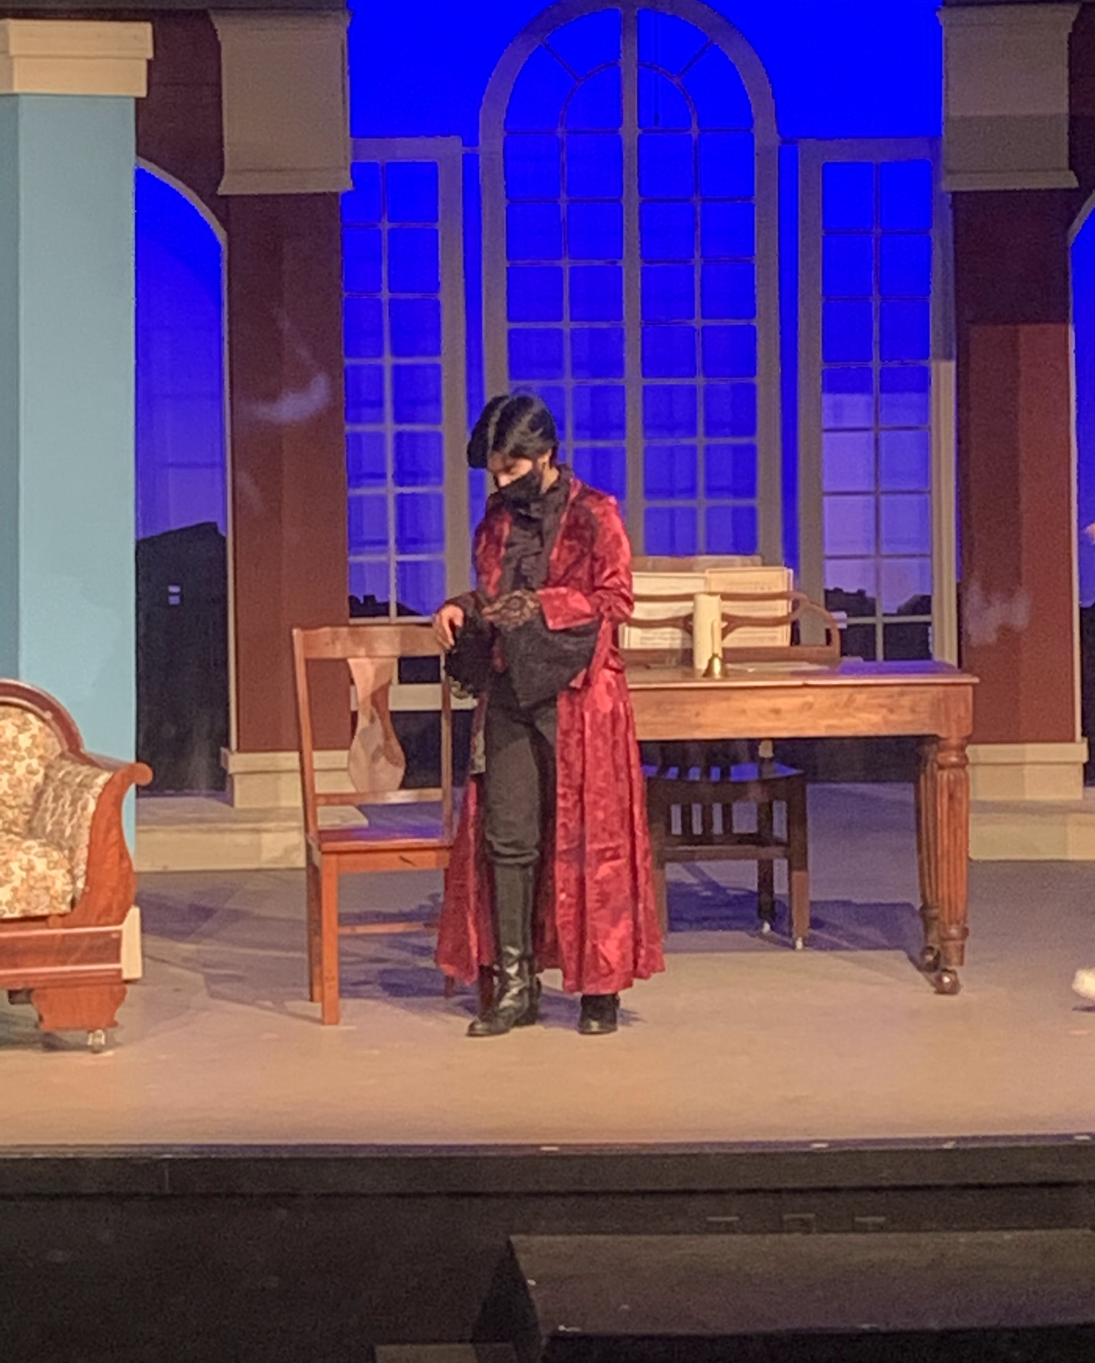
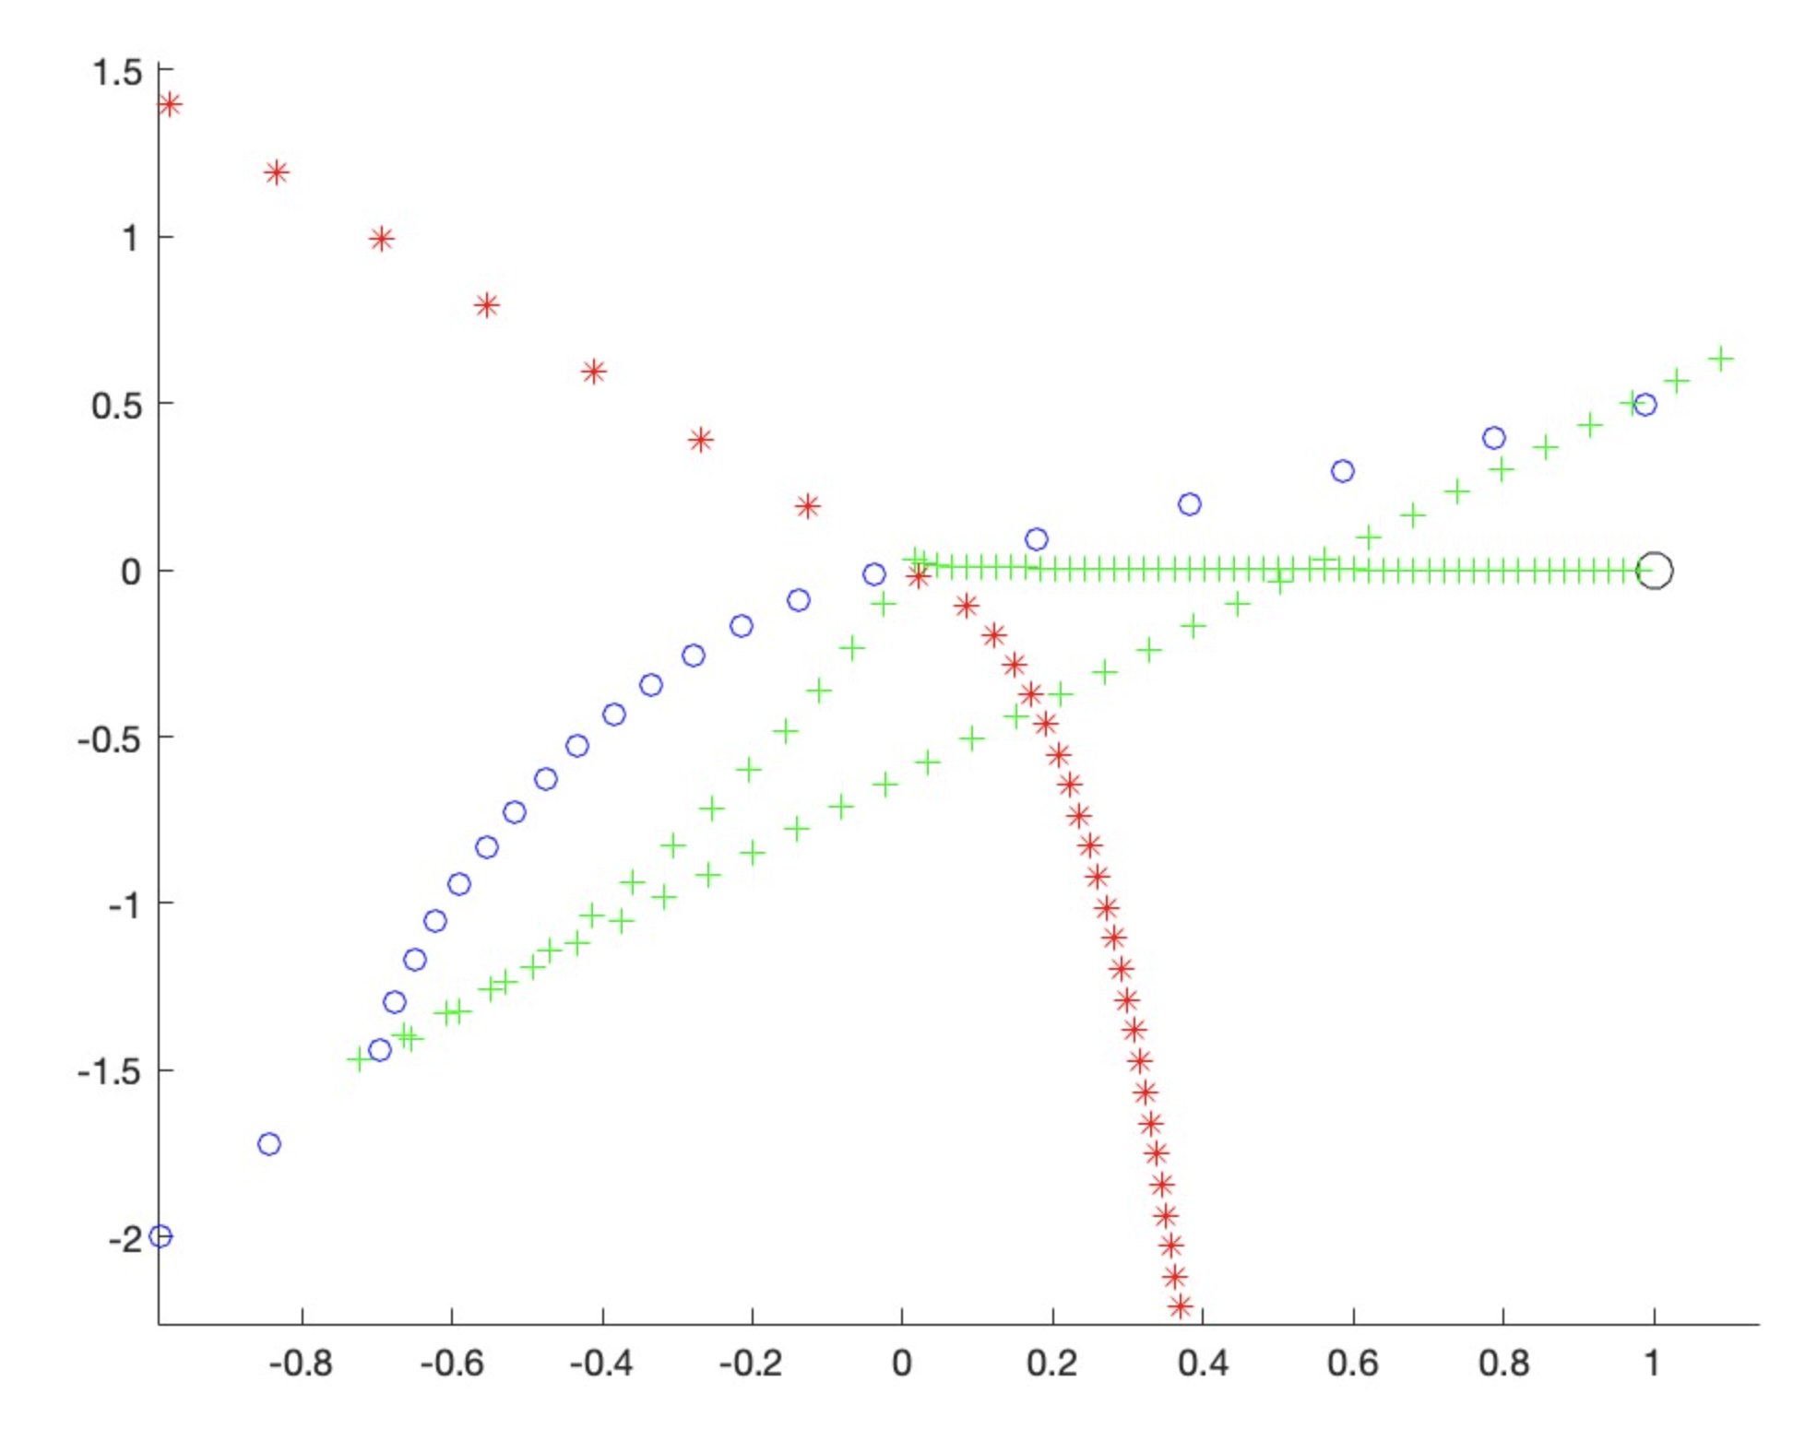
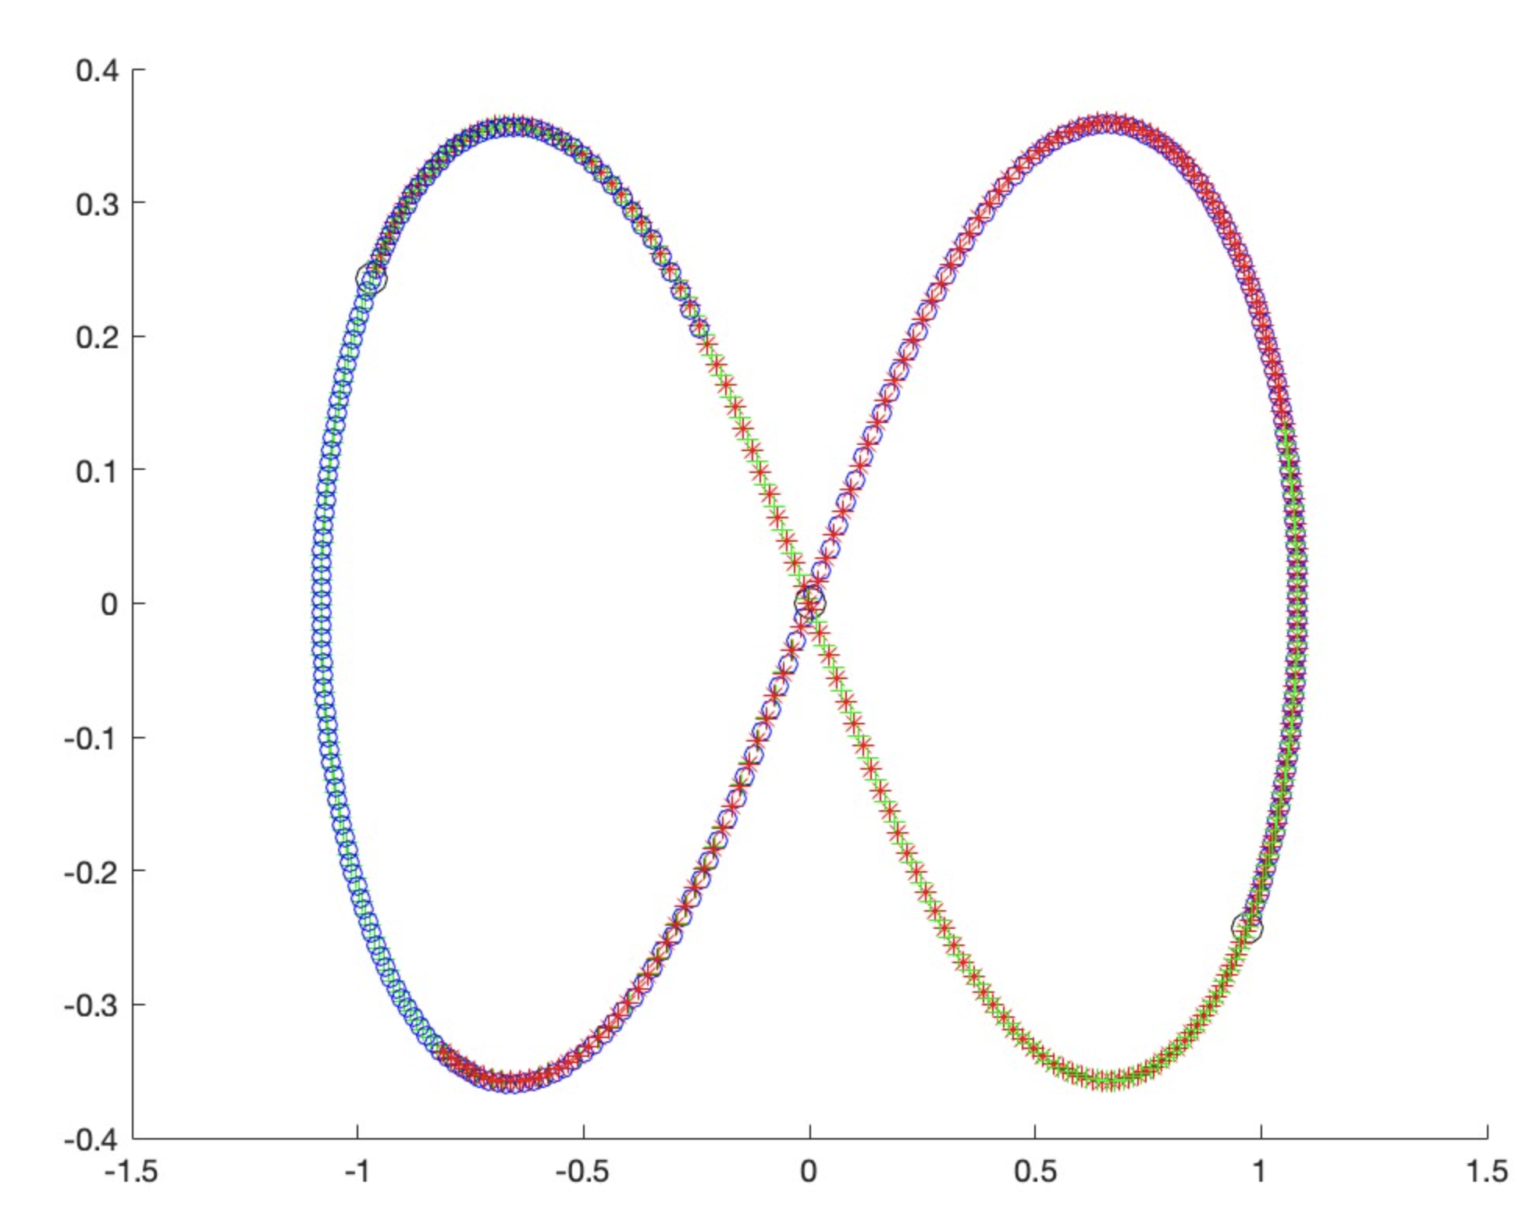
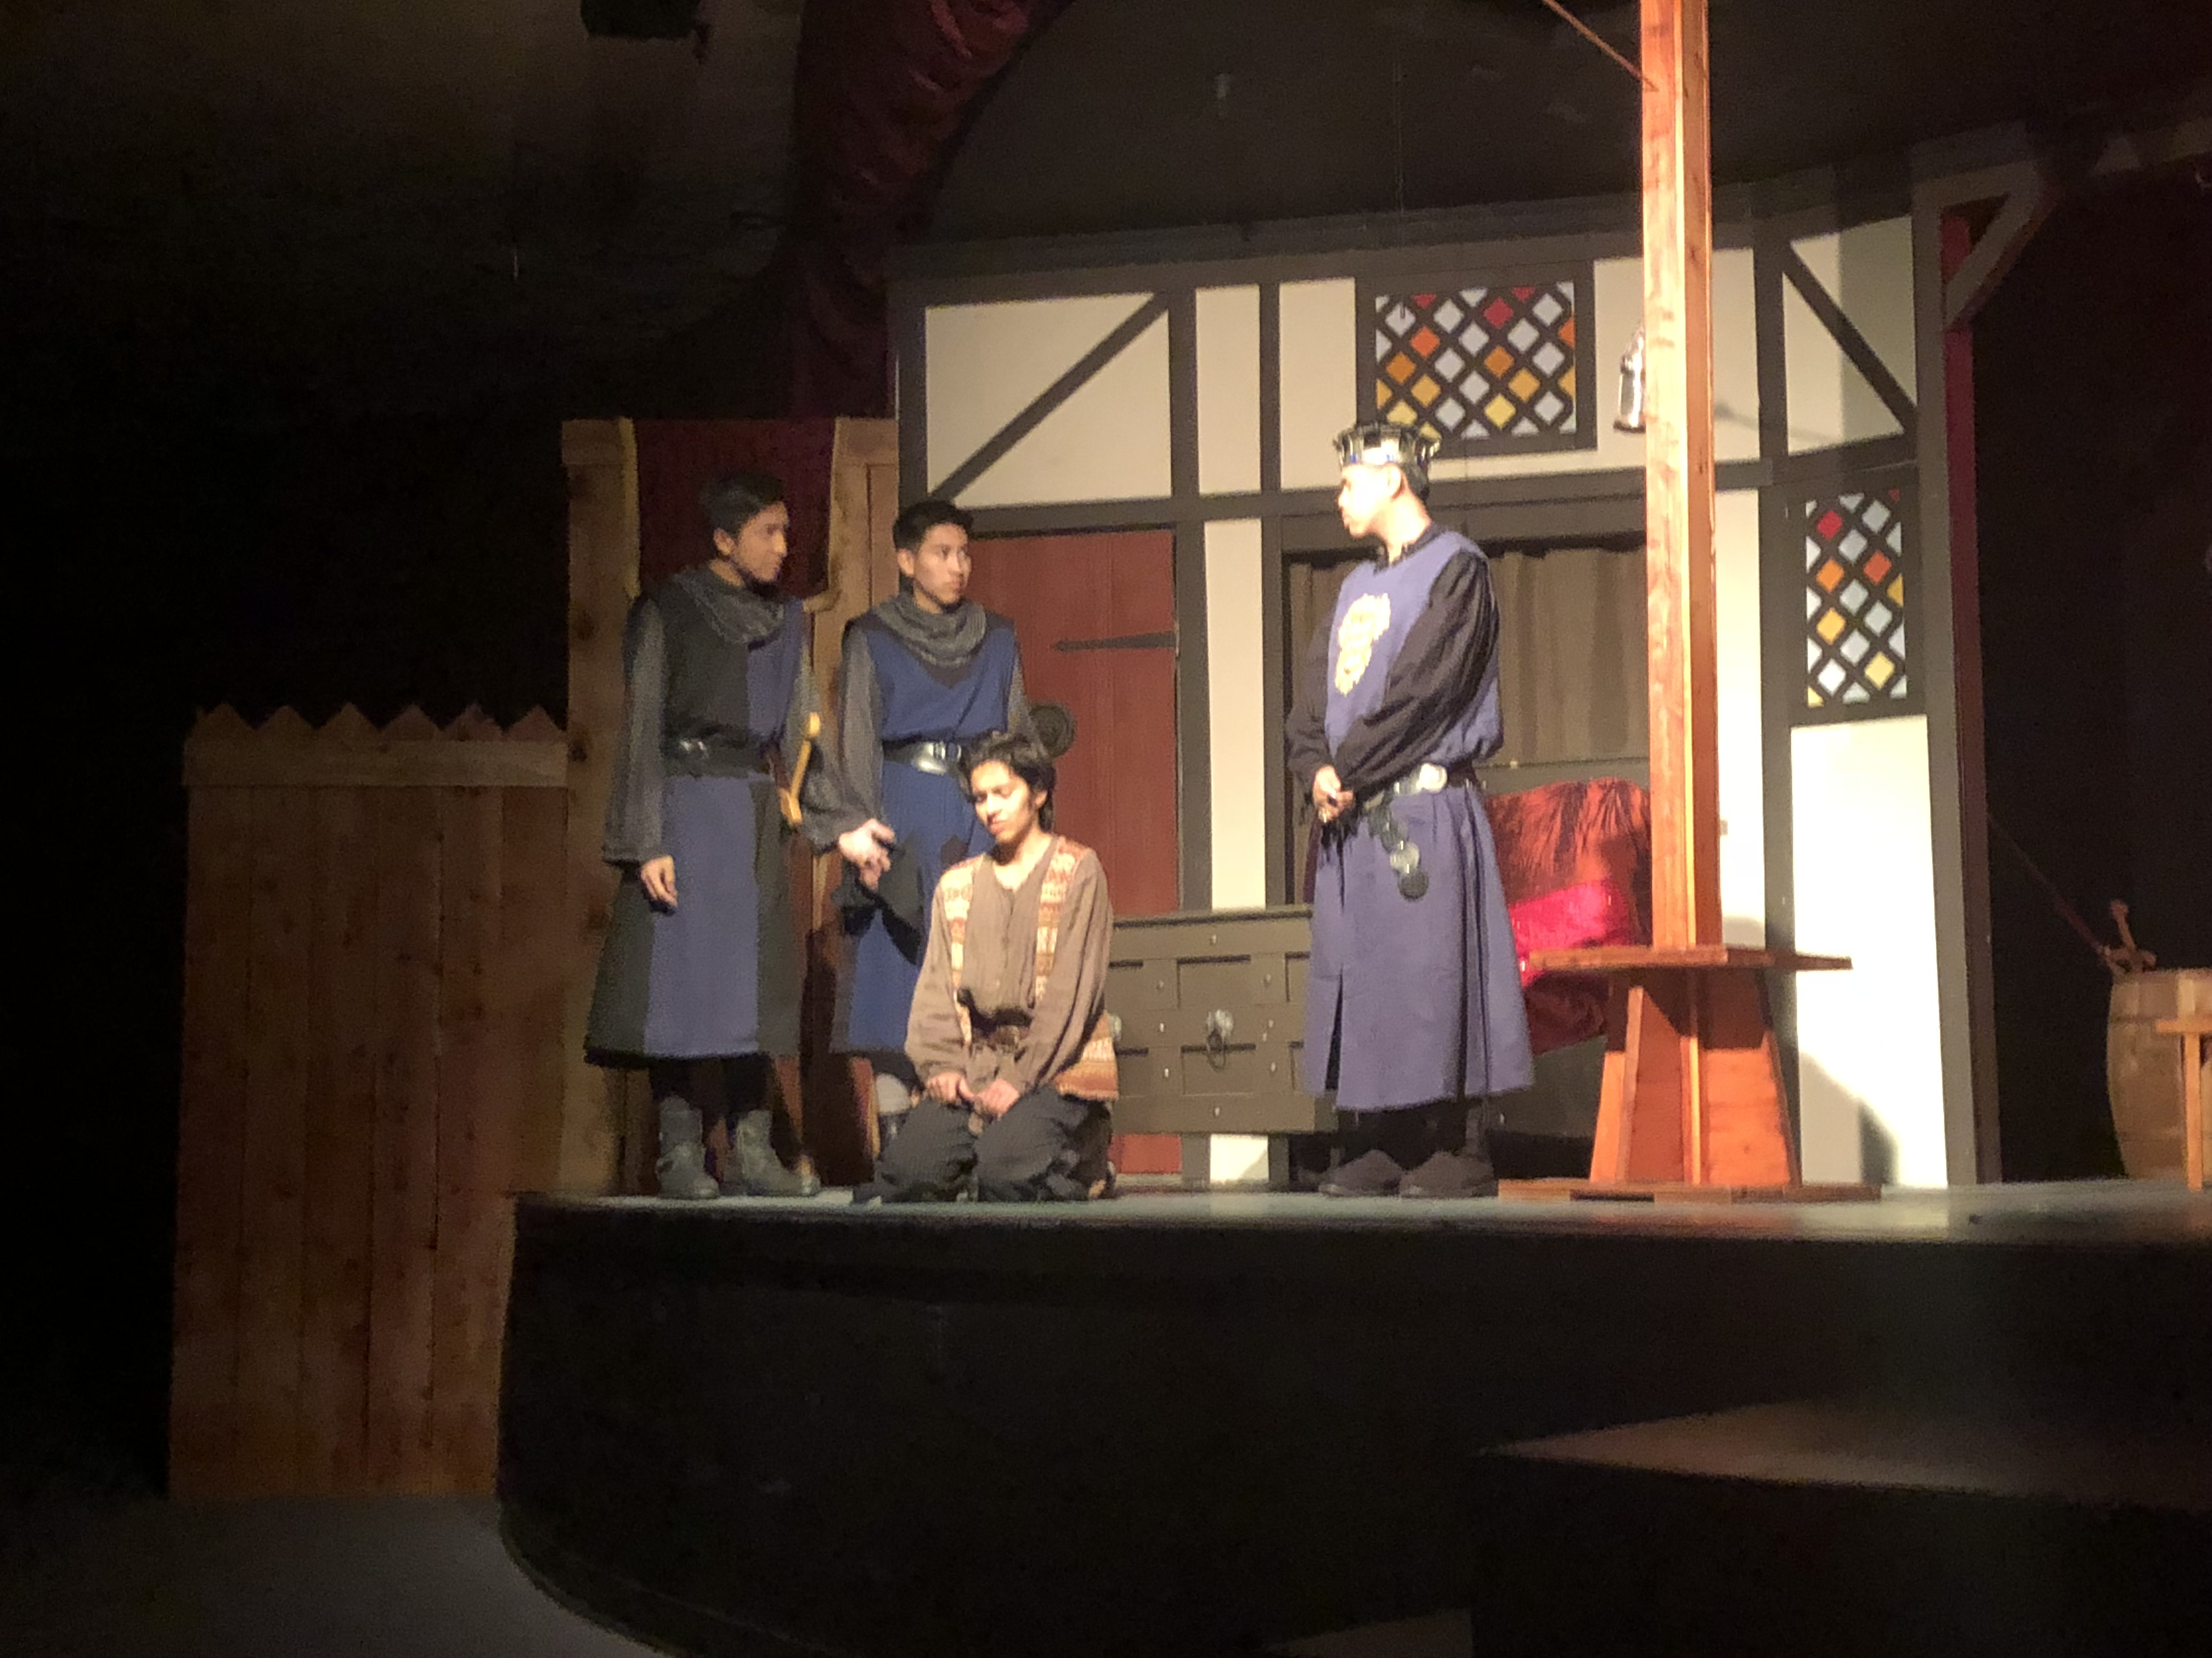
Interesting Stuff
Theater = fun
Three-Body Problem is kinda pointless but kinda cool

